Slide 1
SIMULTANEOUS LOCALIZATION AND MAPPING USING THE EXTENDED KALMAN FILTER
Agata Szeremeta
ESS 5430: Final Project Presentation

Slide 2
EKF slam Introduction

Slide 3
SIMULTANEOUS LOCALIZATION AND MAPPING (slam)
SLAM is method of mapping an unknown environment, while simultaneously localizing the moving mapping sensor within it
Problem requires information regarding the mapping agent’s pose in order to map the environment while also requiring such a map to determine the robot’s relative pose and trajectory
This “Chicken and Egg” problem makes the task difficult to complete
Localize
Map
Notes:
Localizing – method of determining pose (position and orientation) of the mapping sensor
Mapping – involves determining the position of features in the environment, relative to the mapping sensor - SLAM is difficult problem to complete, as robot path and map are both unknown but required

Slide 4
INTRODUCTION: THE NEED FOR Ekf Based SLAM
To understand the need for EKF in SLAM, consider a moving agent (robot) attempting to map an environment.
The agent uses:
Auxiliary sensors (ex. cameras, LiDAR, RADAR) to detect features (to be mapped) in environment
Additional sensor data (ex. odometry from wheel encoders) to localize itself in environment
Unfortunately both sensors are imperfect (as is case in real life)
Sensor data contains noise

Slide 5
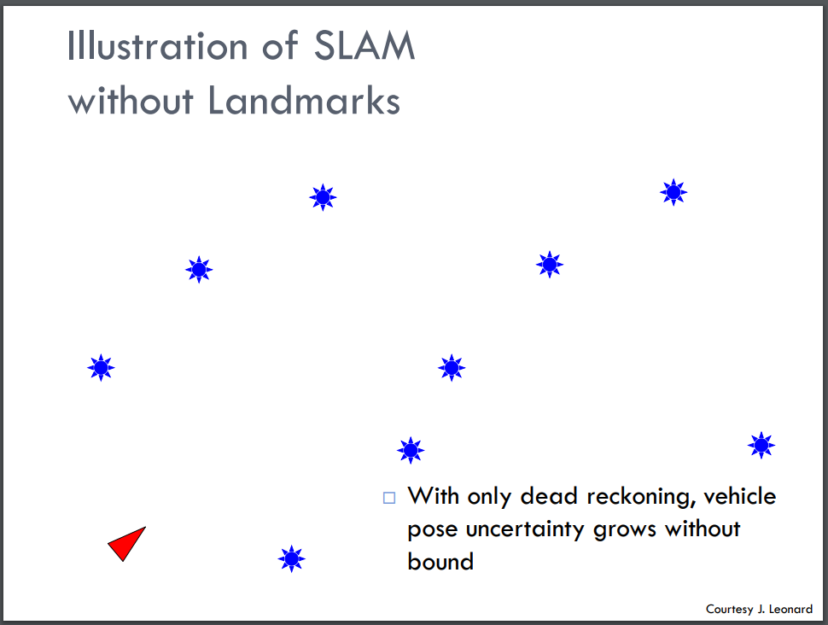
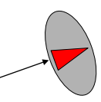
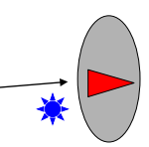
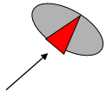
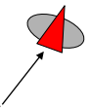
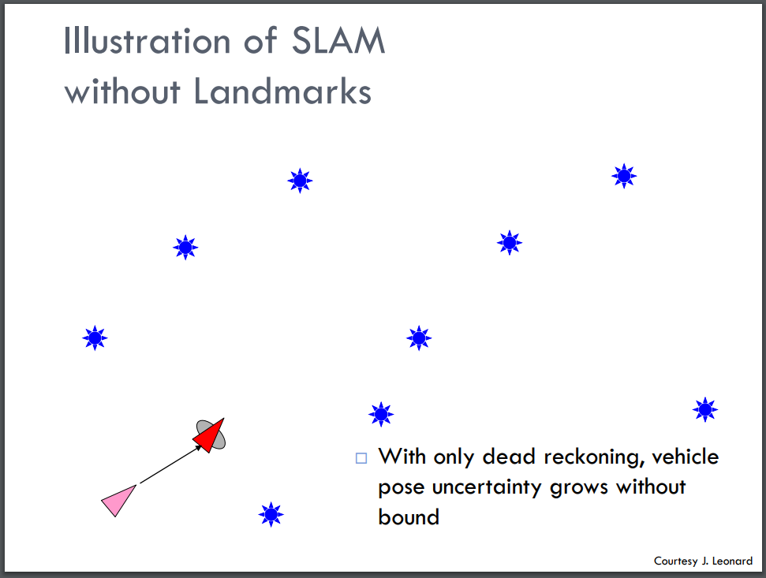
INTRODUCTION: THE NEED FOR Ekf SLAM
By using only dead reckoning techniques, uncertainty errors in the odometry data propagate throughout agent’s motion^{[1]}
[1]
Notes:
Dead reckoning – process of determining pose relative to previous using differential data (such as odometry)
- As observed, uncertainty increases with each motion of the agent

Slide 6
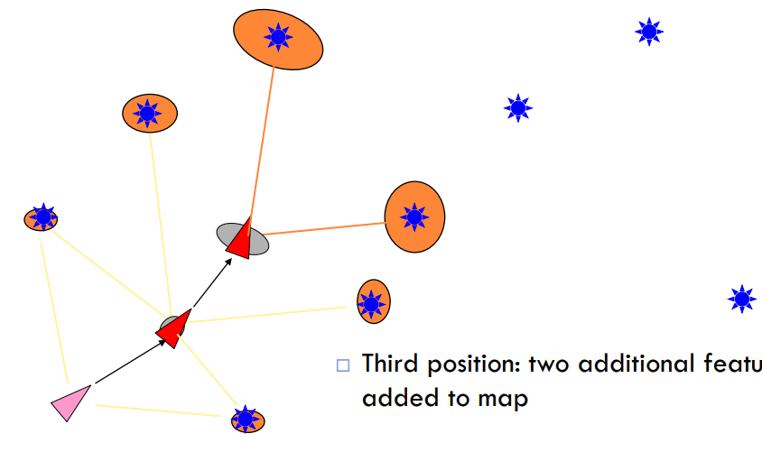
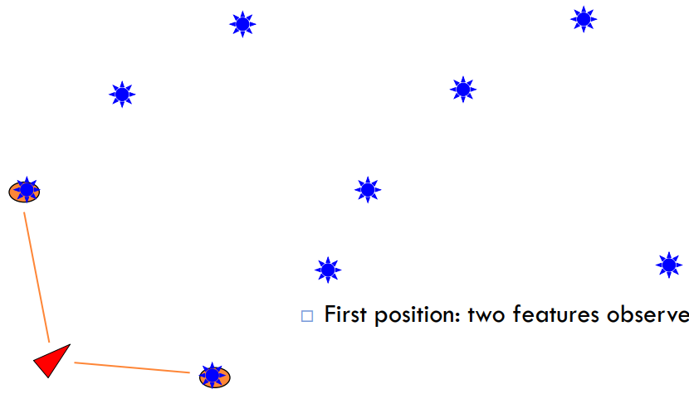
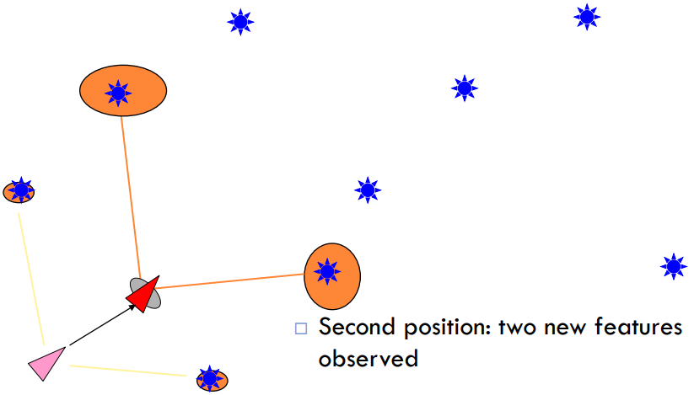
INTRODUCTION: THE NEED FOR Ekf SLAM
These pose errors, in addition to the errors of the measuring sensor, also propagate into the uncertainty of the map generated from observing the landmarks
[1]
Notes:
Dead reckoning – process of determining pose relative to previous using differential data (such as odometry)
- As observed, uncertainty increases with each motion of the agent

Slide 7
INTRODUCTION: THE NEED FOR Ekf SLAM
To minimize the uncertainty of the agent pose and map, data fusion techniques can be applied on data collected through auxiliary sensors
Observations of landmarks can be used to improve the estimated pose of the agent and map
Most common and significant technique: EKF SLAM^{[2]}

Slide 8
BACKGROUND: The Extended Kalman Filter (EKF)
Kalman Filtering (KF) is an optimal method of estimating and filtering states in linear Gaussian systems^{[3]}
The Extended Kalman Filter (EKF) is an extension to the Kalman Filter which allows it to be applicable to cases where the state transitions and measurements are nonlinear.
Notes:
EKF is not entirely the linearized version of the KF, as there exist underlying differences in beliefs
However, not further discussed in presentation and instead can be better understood in [2]

Slide 9
BACKGROUND: The Extended Kalman Filter (EKF)
The general KF and EKF algorithm follow two main steps: 1. State Prediction
2. State Correction
The state is first predicted from an expected control input
It is then used to predict what a measurement to a landmark will be
Finally, the disparity between this predicted measurement and the true measurement is used to compute a gain term, by which the prediction needs to be updated by to provide the correct state
This updates both the localization and mapping aspects

Slide 10
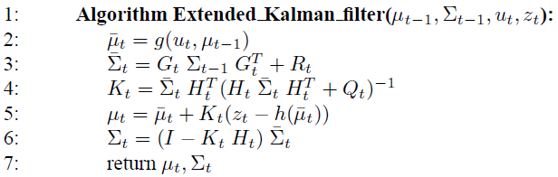
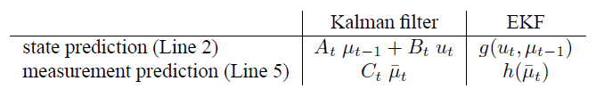
BACKGROUND: The EKF ALGORITHM
[2]
[2]
Notes:
g and h are nonlinear functions with Jacobians G and H
Z_t is the measurement
Equations 2:3 correspond to the prediction step, while 4:6 correspond to the correction step
2: State Vector Prediction
3: State Covariance Prediction
4: Kalman Gain
5: Corrected State Vector
6: Corrected State Covariance

Slide 11
BACKGROUND: EKF SLAM
EKF and SLAM algorithms combine to:
Localize an agent, with nonlinear motion, in an environment by predicting its future position and adjusting this prediction based on the observations of features in the environment
Simultaneously, map features in the environment based on the agent’s localization
Table 1: Comparison of Events in EKF and SLAM Algorithms^{[5]}
Event | Meaning in EKF Algorithm | Meaning in SLAM Algorithm
Agent Moves | EKF Prediction | Agent Motion
Sensor Detects New Landmark | State Augmentation | Landmark Initialization
Sensor Observes Known Landmark | EKF Correction | Map Correction

Slide 12
BACKGROUND: EKF SLAM in ROBOTICS
Often, EKF SLAM algorithm is used in robotics to localize a robot that^{[3]}:
Moves in a 2D plane, using velocity based motion model as its control input
Performs Range-Bearing observations to point landmarks
The robot can:
Either know total number of landmarks in environment or not
Either know to which landmark it is observing or not
Often, does not know either and must perform some sort of data association to determine whether is observing a new or old landmark^{[2]}
Notes:
EKF SLAM can be applied to 3D cases with the appropriate augmentation of matrices
Because 2D case is considered for the project, it is focus of discussion
Methods of knowing with landmark is being observed include having each landmark be unique. Examples include:
Through different colours
Barcodes
Shapes
Not knowing which landmark results in EKF SLAM with Unknown Data Correspondance (the most general case) [2]

Slide 13
BACKGROUND: EKF SLAM WITH UNKNOWN DATA ASSOCIATION
This unknown data association in EKF SLAM is considered the general EKF SLAM problem
Because sensor does not know the landmark it is observing, needs to determine correspondence with previously mapped landmarks
If already observed landmark, use information to adjust estimated pose and map
If new landmark, augment it to the map and adjust pose accordingly
Many correspondence techniques exist, however, commonly used in EKF SLAM is Maximum Likelihood
Notes:
- ML is only briefly discussed later in the presentation in the implementation section due to the previous presentation on the estimator

Slide 14
BACKGROUND: SUMMARY OF EKF SLAM STEPS
State Prediction
Data Association
Measurement Prediction
Measurement
Update
Robot State Prediction
Landmark Data Association
Robot Measurement Prediction
Landmark Measurement
State Update
Notes:
Right flow chart, defines cycle specific to robotics

Slide 15
EKF slam implementation for project

Slide 16
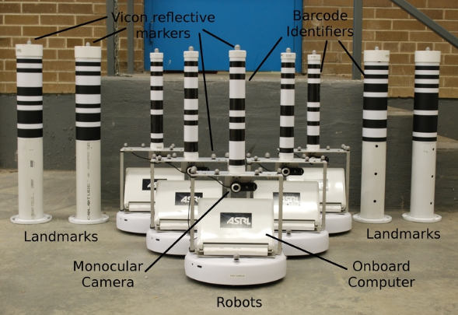
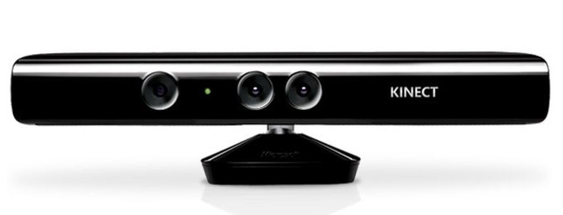
PROJECT: EKF SLAM IMPLEMENTATION
An EKF SLAM algorithm was trialed on two systems:
1. Data provided by University of Toronto Aerospace Studies (UTIAS) Autonomous Space Robotics Lab^{[4]}
2. Self-collected data using moving Microsoft Kinect RGB-Depth sensor
Complete implementation using external data
Incomplete implementation using Kinect data
^{[6]}
^{[7]}
Notes:
- Since, unable to successfully implement the algorithm on the Microsoft Kinect data, the focus of the presentation will be on the external data

Slide 17
PROJECT: External Data System
Part of dataset collection provided by Autonomous Space Robotics Lab for educational purposes
Originally for Cooperative Multi-Robot Localization and Mapping
Individual robot data could be extracted from dataset
Beneficial because provided all necessary data to implement EKF SLAM and assess results
Downloadable at:
http://asrl.utias.utoronto.ca/datasets/mrclam/#Download
Notes:
- In addition to EKF SLAM necessary data, authors provided 3 tools to load and sample the collected data and animate the found results

Slide 18
PROJECT: External Data System
The collection consisted of 9 datasets, which each included:
Odometry data of each of 5 robots
Range and bearing measurements from robots, found by processing images of onboard monocular camera
Accurate ground truth data for all robot poses and 15 landmarks in environment
Due to barcodes on landmarks, robots were aware of the landmark associated with each observation
This was ignored and EKF SLAM with unknown data association was still implemented

Slide 19
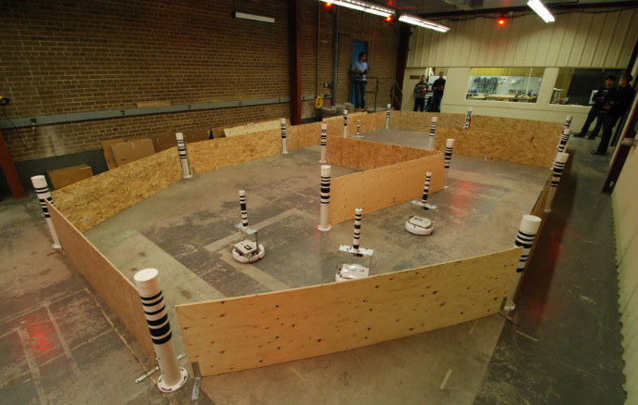
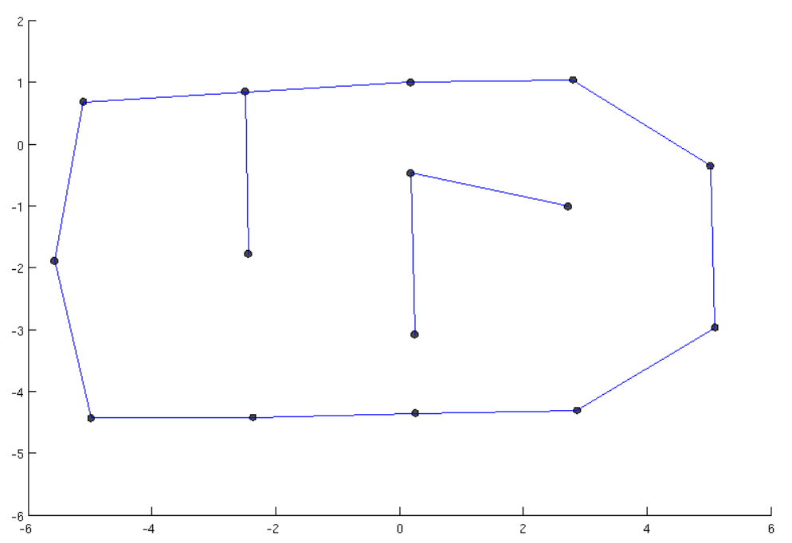
PROJECT: External Data System
Robot #1’s observations in dataset #9 was chosen for initial study
Algorithm is expected to function on any robot number in any dataset
Chose dataset #9 because of included occlusions:
^{[6]}
^{[6]}
Notes:
Included occlusions could act as a means to validate EKF SLAM results
Obviously, the robot cannot be located beyond the barrier wall

Slide 20
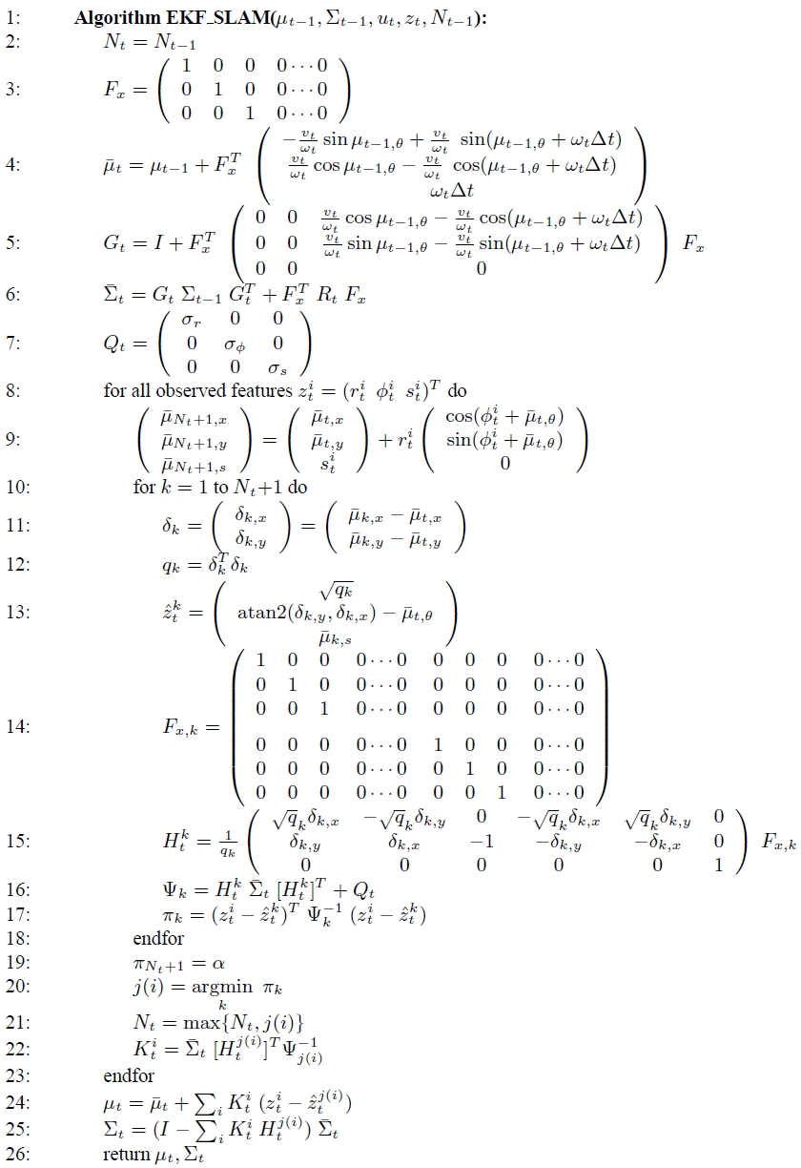
Project: EKF SLAM PSEUDOCODE
State Prediction Steps
Observation Steps
Data Association Steps
State Update Steps
[2]
Notes:
- Pseudocode provided in and modified from [2]

Slide 21
PROJECT: MODIFICATIONS TO PSEUDOCODE
Unfortunately, exact errors for the motion model and measurement sensors were not provided
Their values were arbitrarily chosen
Maximum likelihood correspondence was used with Mahalanobis Distance
For each observed landmark, the distance between that landmark and all previously observed was computed
If the found distance was greater than a defined threshold, then landmark was potentially new
To classify as entire new, the landmark also had to be more unique/different from its closest associated match
Notes:
Due to the brittleness of the ML association process, mainly in confusing landmarks, the observed landmark had to be ensured as significantly difference and far from other previously mapped landmarks [2]
Minimized the probability of associating poorly due to errors etc.

Slide 22
implementation results

Slide 23
Project: Results of EKF SLAM on External Data
Algorithm is able to estimate pose and landmark location from the given data
Unfortunately, trajectory does not appear to be correct (discussed in next slides)
Run time: 64.8999 seconds or 1.0817 minutes
Statistics on error between ground truth and estimated trajectories:
Statistic | X Value (m) | Y Value (m) | Theta Value (rad)
Minimum | -16.2101 | -14.1675 | -6.2701
Maximum | 2.9653 | 7.7197 | 6.2249
Mean | -6.2890 | -2.6183 | -0.0790
Standard Deviation | 4.8670 | 5.9465 | 2.4976
Notes:
Although run time is dependent on the data association levels, number of measurements, etc.
Error is greater than size of environment

Slide 24
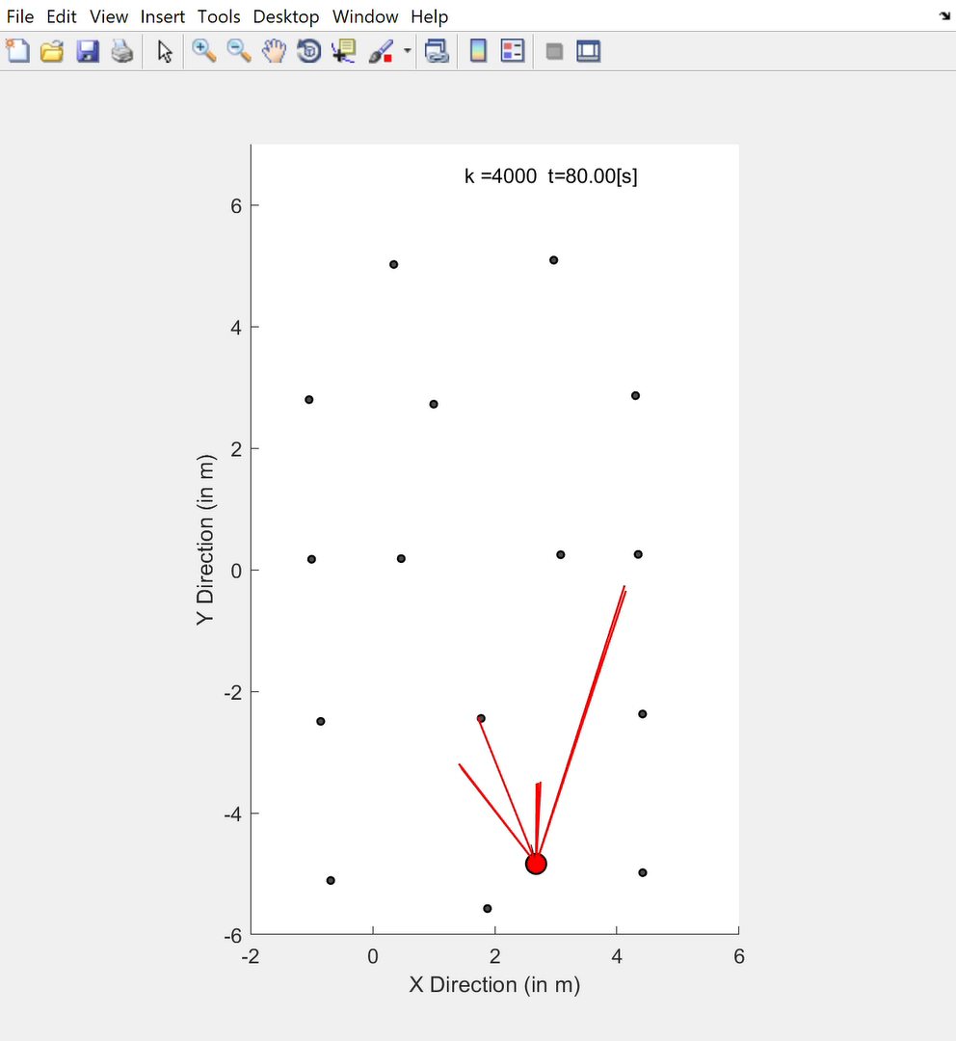
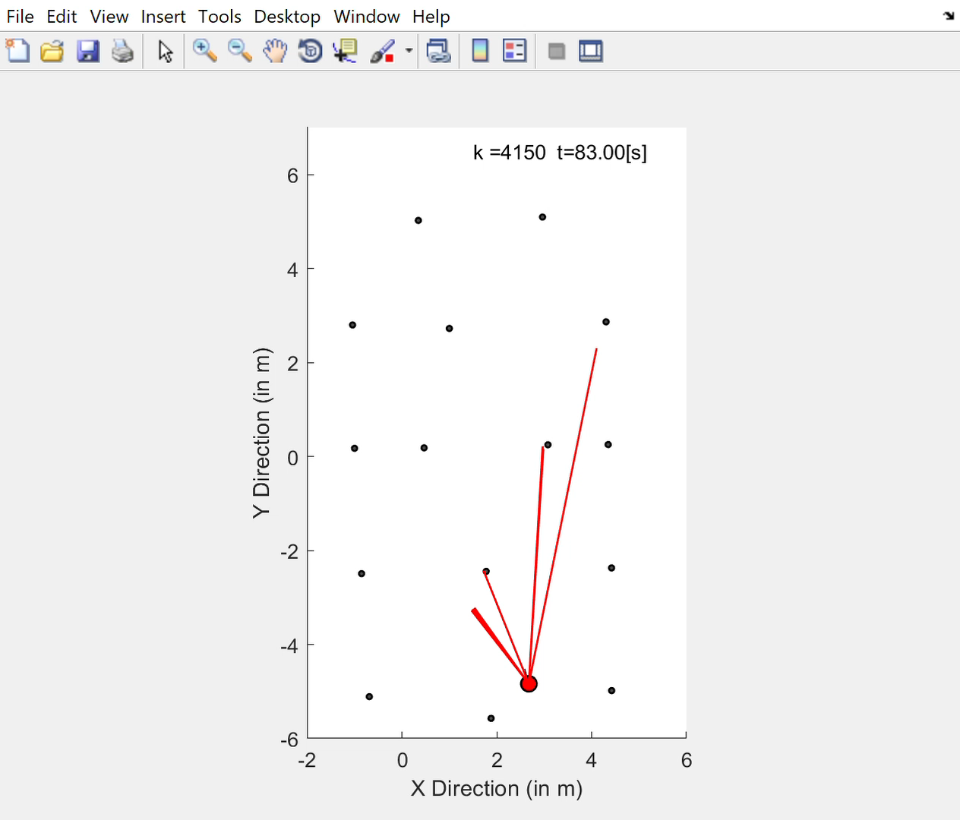
Project: Results of EKF SLAM on External Data
Observe robot to be localized outside of barrier wall (which should have been physically impossible)
Comparing to animation of ground truth trajectory, observe EKF SLAM estimated position to be more sporadic
Estimated Trajectory
Ground Truth Trajectory

Slide 25
Project: Results of EKF SLAM on External Data
Possible explanation for errors:
In observation extraction code
Introduced when modifying given result animation script into function
Poor noise parameters (therefore, poor estimations and predictions)
Possible errors in provided data

Slide 26
Project: Results of EKF SLAM on External Data
When running same code on different dataset (ex. Robot #4 of Dataset #1), have results closer to what is expected
Run time: 22.4804 seconds
Statistics on error between ground truth and estimated trajectories:
Statistic | X Value (m) | Y Value (m) | Theta Value (rad)
Minimum | -3.8137 | -0.7301 | -6.2665
Maximum | 1.0992 | 1.2084 | 6.1825
Mean | -0.6431 | 0.3678 | 0.0083
Standard Deviation | 1.1851 | 0.4531 | 0.8723
Notes:
Observe significant improvement in results
Decrease in error and increase in processing speed

Slide 27
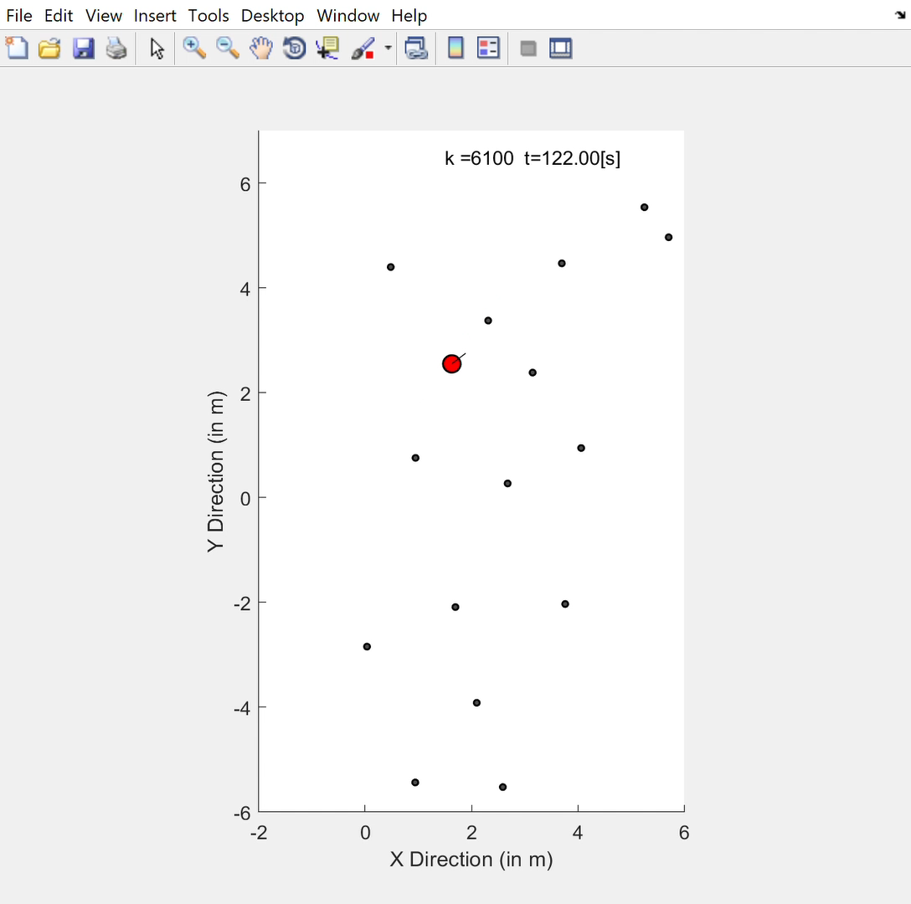
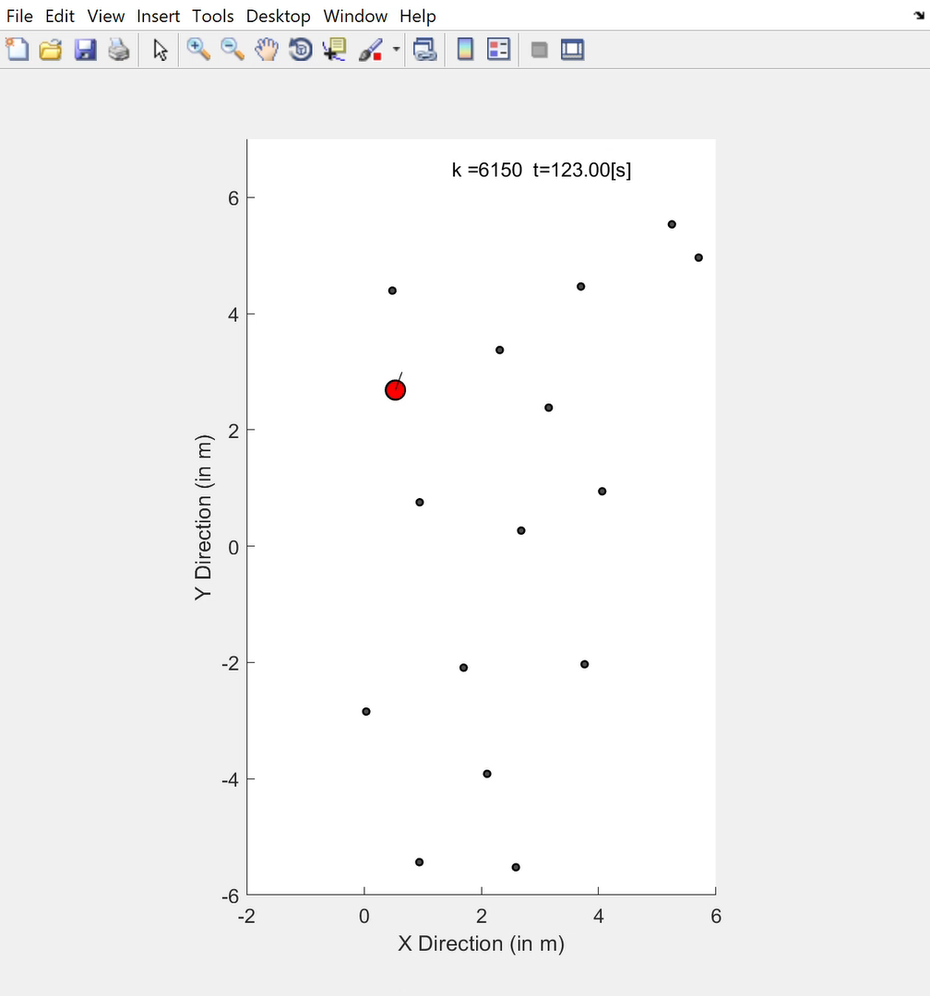
Project: Results of EKF SLAM on External Data
Ground Truth Trajectory
Estimated Trajectory

Slide 28
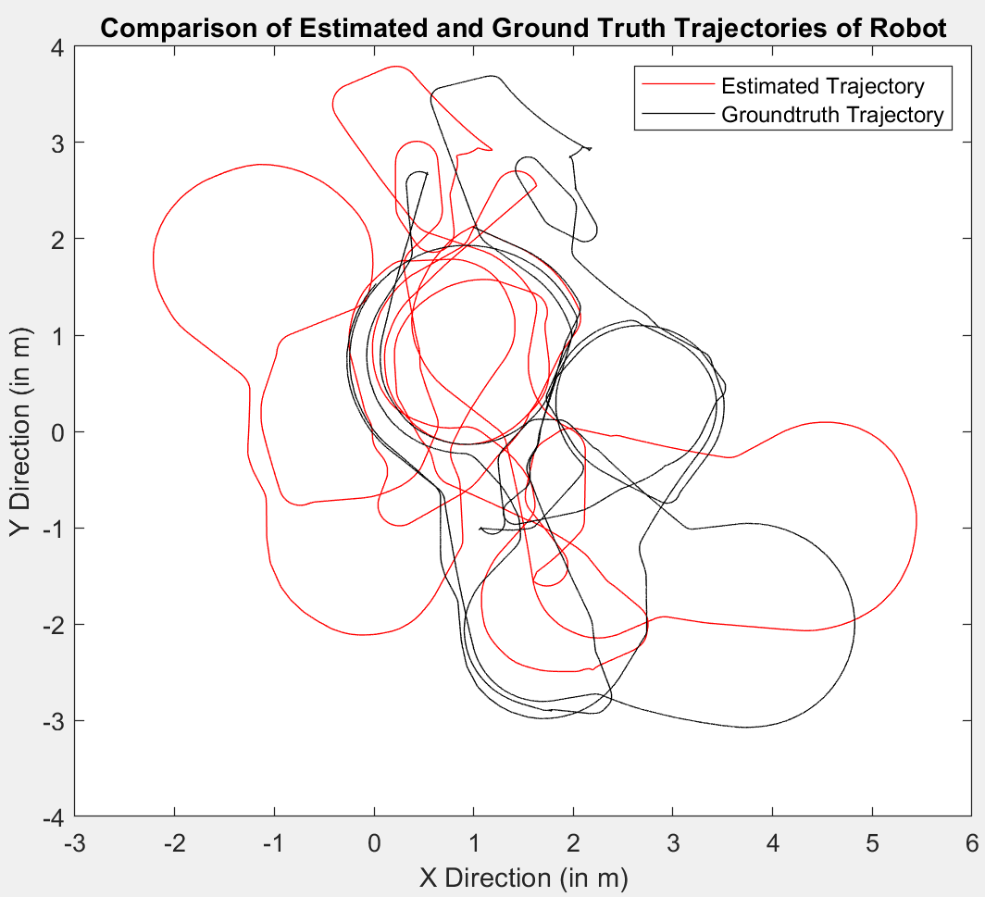
Project: Results of EKF SLAM on External Data
Comparing ground truth to estimated still observe some noise
Ground truth trajectory shows patterns
Estimated still shows sporadic motion
Can be indicative that more errors lie in code

Slide 29
Additional implementations

Slide 30
Project: Additional Implementations
Attempted to implement EKF SLAM on data acquired through moving Kinect RGB-D sensor
Two cases:
1. Kinect moved in one direction, towards single landmark in horizontal plane
2. Kinect moved in two directions in horizontal plane, locating artificial visual targets
Unsuccessful implementation likely due to lack of correct odometry data and coordinate frames
Software has possibility to function correctly with few modifications
Notes:
Not exactly real-time, as performed in discrete intervals
Initially Kinect was moved manually with later hopes of being fixed on a 4-wheel cart (without wheel encoders)
Although unsuccessful, process still discussed

Slide 31
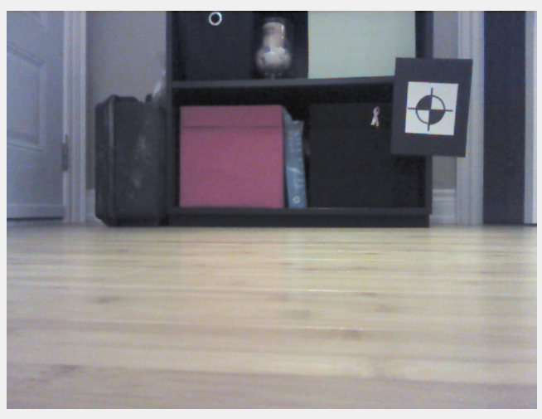

Project: Additional Implementations
Kinect sensor provided RGB and Depth images of an environment
Goal was to identify position of target using RGB image and associated depth from camera using depth image

Slide 32
Project: Additional Implementations
First Case Steps:
Motion model/uncertainty determined by sampling my single step and finding its mean and deviation
Measurement (range) uncertainty determined by analyzing disparity between true depth to known point and measured
Kinect sensor moved on floor towards a wall, in a straight line by a step at a time
Assumed that the change in heading (angle) of the camera was 0
RGB and Depth images taken manually at each point
The principal point of the depth camera images was taken as landmark in each iteration
Implementation:
Linear motion therefore applied Kalman Filter
Notes:
Both cameras were calibrated to obtain their individual intrinsics and extrinsics
Straight line motion meant that the odometry was solely forward velocity with not angular influence
Since observing wall, deemed sufficient to use principal point as not expected large deviations in depth
Still needed to perform data association steps

Slide 33
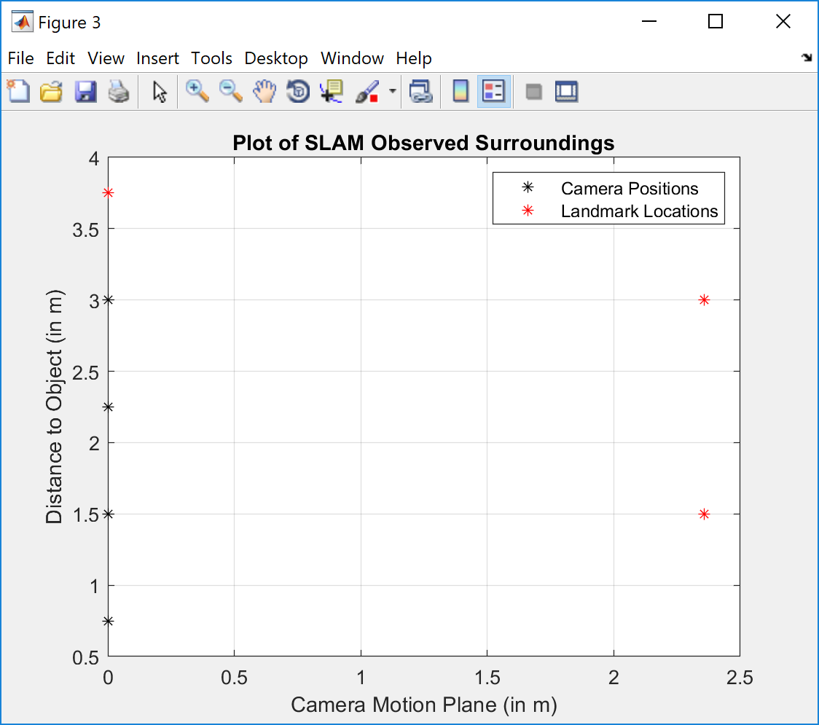
Project: Additional Implementations
Results:
X Position (m) | Y Position (m)
0.75 | 0
1.499999 | 0
2.249999 | 0
2.999996 | 0
3.749996 | 0
Notes:
Assumed no bearing motion, therefore, no change in Y Position
Although, realistically, there is possibility of bearing change
Observed forward motion of sensor, however incorrect identification of landmarks
This could possibly be due to the images taken and using the principal point as the target

Slide 34
Project: Additional Implementations
Results:
X Position (m) | Y Position (m)
0.75 | 0
1.499999 | 0
2.249999 | 0
2.999996 | 0
3.749996 | 0
Notes:
Assumed no bearing motion, therefore, no change in Y Position
Although, realistically, there is possibility of bearing change
Observed forward motion of sensor, however incorrect identification of landmarks
This could possibly be due to the images taken and using the principal point as the target

Slide 35
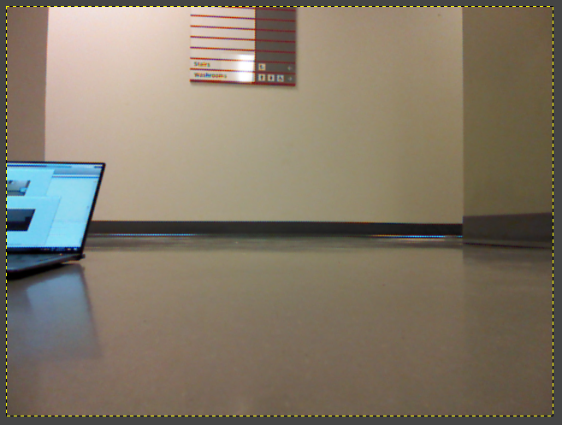
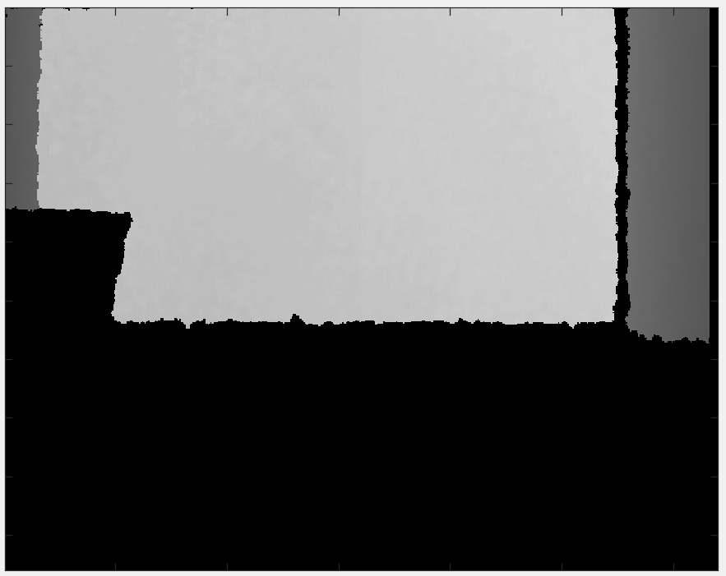
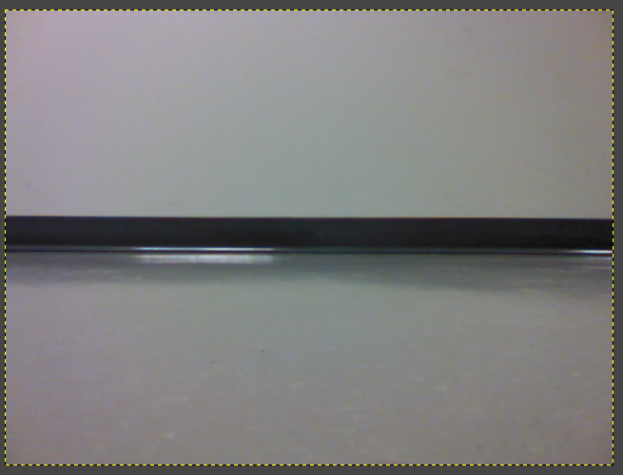
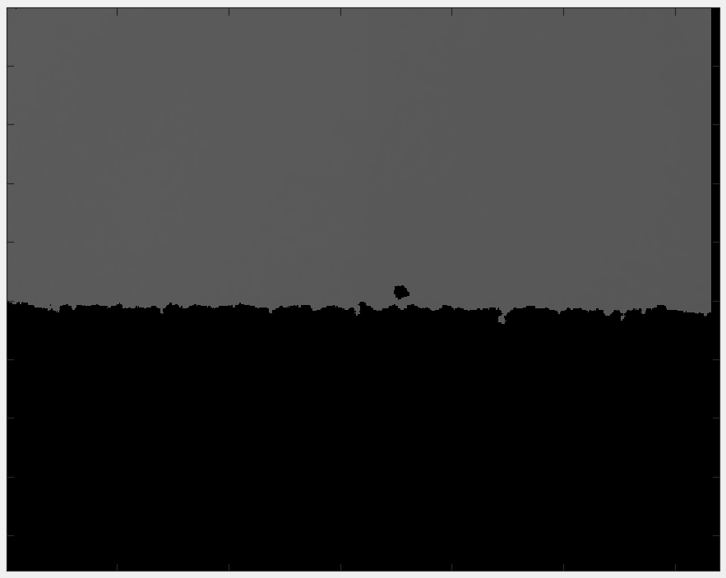
Project: Additional Implementations
Images likely source of error:
Sensor unable to identify depth of features within approximately 1m and beyond 4m
Unable to provide depth to floor, which might be included in analysis of principal point region
Notes:
Assumed no bearing motion, therefore, no change in Y Position
Although, realistically, there is possibility of bearing change
Observed forward motion of sensor, however incorrect identification of landmarks
This could possibly be due to the images taken and using the principal point as the target

Slide 36

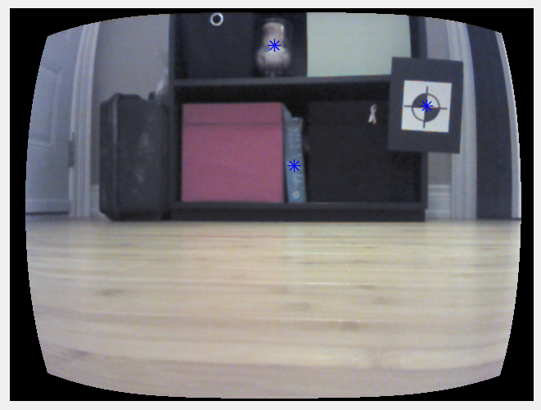
Project: Additional Implementations
Seconds Case Steps:
Odometry determined by applying visual odometry methods
Involved determining relative camera locations and orientation from matching features in sequential images
Kinect sensor moved in environment containing identical targets which acted as landmarks
RGB and Depth images taken through manual trigger at each point
Measurements of range and bearing found through:
Centroid of targets identified in each RGB image
From this, angle of target to camera principal point was found (acted as bearing)
Depth to this target centroid was found (acted as range)
Notes:
Since implemented visual odometry methods, motion was not restricted to be in a straight line
Algorithm failed to identify targets unless distinct contrast therefore against black background
Due to nonlinearity of motion, EKF SLAM algorithm applied

Slide 37
Project: Additional Implementations
Error arose from:
Differences in coordinate systems of camera (i.e. x,y - pixels) and real-world (i.e. depth - metres)
Because Kinect sensor RGB camera not truly a stereo system, could not acquire real-world coordinates of target centroids for map
Visual odometry also provided relative camera poses in previous camera coordinate frame (not real world)
This caused errors when using EKF SLAM algorithm, since it transformed matrices to the 2D real-world state space
Inability of visual odometry algorithm to determine relative pose without strong overlap between images
Poor target detection at oblique camera angles
Notes:
- Since implemented visual odometry methods, motion was not restricted to be in a straight line

Slide 38
Project: Additional Implementations
Additional comments:
How could odometry data help?
Would provide true real-world coordinate system motion
Reduces errors associated with the relative camera pose algorithm and the need for a scaling term
To account for differences in coordinate frames:
Could apply Structure From Motion (SFM) techniques and triangulate to find 3D coordinates of features^{[8]}
Requires features to be observed 3 different frame (observed in 1st frame, re-observed and triangulated in 2nd frame, and used to calculate transformation in 3rd frame)
Notes:
Have not tested latter, but expect it to work
However, may not be efficient as required additional pre-processing steps to determine initial 3D camera coordinates (i.e. camera coordinate frame)

Slide 39
Future Improvements

Slide 40
Project: Future Improvements to Algorithm
To improve processing capabilities of the software algorithm^{[2]}:
Limit the number of landmarks considered in the data association step
Reduce probability of false data associations by making landmarks more unique and further apart
Remove/augment the system, accordingly, for landmarks that have not been observed recently
To improve uncertainties in results of the software algorithm^{[2]}:
Use a provisional landmark list to compensate for extreme outliers
Measurement errors can create fake landmarks and cause wrong corrections to be applied to the estimated pose
Can add landmark to map only if it’s consistency observed and its uncertainty decreases
Notes:
Can limit the number of landmarks by selecting only those nearby the sensor therefore, reducing the number of iterations necessary for a complete solution
Limit to those within maximum observation range and field of view
However, it should be noted that making such changes to the number and placement of landmarks in the environment can result in poor estimation of the pose [2]
This too is a chicken and egg problem – Sparser environment causes EKF SLAM to struggle performing localization, while denser environment causes landmark confusion

Slide 41
Good Sources for further research
1. Thrun, W. Burgard and D. Fox, Probabilistic Robotics, Draft ed., 2000.
2. C. Stachniss, "Robot Mapping: EKF SLAM," Albert-Ludwigs-Universitat Freiburg, Frieburg im Breisgau.
3. C. Stachniss EKF SLAM Video Series on Youtube
4. J. Sola, "Simultaneous Localization and Mapping with the Extended Kalman Filter," 2014.

Slide 42
REFERENCES
[1] E. Olson, "L11. EKF SLAM: Part 1," University of Michigan, Ann Arbo.
[2] Thrun, W. Burgard and D. Fox, Probabilistic Robotics, Draft ed., 2000.
[3] C. Stachniss, "Robot Mapping: EKF SLAM," Albert-Ludwigs-Universitat Freiburg, Frieburg im Breisgau.
[4] J. Sola, "Simultaneous Localization and Mapping with the Extended Kalman Filter," 2014.
[5] Merriam-Webster Dictionary, "Maximum Likelihood," 2019. [Online]. Available: https://www.merriam- webster.com/dictionary/maximum%20likelihood. [Accessed 12 01 2019].
[6] K. Y. K. Leung, Y. Halpern, T. D. Barfoot and H. H. T. Liu, "The UTIAS Multi-Robot Cooperative Localization and Mapping Dataset," International Journal of Robotics Research, vol. 30, no. 8, pp. 969-974, July 2011.
[7] J. Callaham, "Microsoft to End Sales of Original Kinect for Windows Sensor in 2015," 30 12 2014. [Online]. Available: https://www.windowscentral.com/microsoft-end-sales-original-kinect-windows-sensor-2015. [Accessed 13 01 2019].
[8] K. Yousif, A. Bab-Hadiashar and R. Hoseinnezhad, "An Overview to Visual Odometry and Visual SLAM: Applications to Mobile Robotics," Melbourne, 2015.

